Slide 1

Brand Guide
Name, logo, color, type, components and voice
Version 1.1 · matched to plaiceholder.io

Slide 2

The name puts AI at the center
Never write it as
✕ Plaiceholder
✕ PlaiceHolder
Capital P · lowercase l · capital AI · lowercase ceholder
✕ PLAICEHOLDER
We fill the places in your week that are waiting for AI.
✕ Placeholder AI
plaiceholder.io: lowercase in URLs and email

Slide 3


One wordmark, two fills, one icon
Gradient: nav bar, white and mint backgrounds
White: footer, gradient banners, photos
The whole word takes the gradient
Don't color the AI separately
Clear space and size
Height of the A on every side · 96 px minimum
Icon and favicon
Gradient circle, white A, weight 800

Slide 4



Four ways not to use the logo
✕ Squashed or stretched
✕ Shadows or glows
✕ All capitals
✕ Gradient on gradient
On a gradient, a photo or anything busy, use the white wordmark.

Slide 5

The gradient leads; navy and mint hold it up
Blue
#1A6EF5
Sea
#3EC9C9
Green
#2ECC71
Navy
Ink
Muted
Mint
White
Border
#0D1B2A
#1A2E20
#5A7A65
#F4FDF8
#FFFFFF
#DCF5F5
Headings, footer, dark sections
Body text
Secondary text
Page background
Cards, nav bar
Sea at 18%

Slide 6


Two gradients and four badges
Brand gradient
135° #1A6EF5 → #3EC9C9 → #2ECC71
Banners (with dot pattern), primary buttons, wordmark, icons
Dark gradient
135° #0D1B2A → #1A3A5C
Dark panels and feature blocks
Badges on agent cards
Dashboards only (proposed)
Sales
Advanced
Ready now
Available
Low
Medium
High
Area · Tier · Ready · Available: dark text on a light tint of the same hue
Risk and severity in agent dashboards. Not on marketing pages.

Slide 7
Sea and green never carry text
Book a free call
Book a free call
Book a free call
✕ Sea text on white 2.0 : 1
✕ Green text on white 2.1 : 1
✓ Navy on white 17.4 : 1
Book a free call
Book a free call
Book a free call
✓ Ink on mint 13.9 : 1
✓ Blue on white 4.6 : 1
✓ Muted on white 4.8 : 1
White on the gradient: large, bold text only. Small blue text on mint: weight 700 or #1558C7.

Slide 8

Heavy headlines, roomy body
Hero H1
900 · 2.1–3.8 rem
Setup from $1,500.
Section H2
800 · 1.6–2.4 rem
A US automation engineer costs $90,000 to $140,000 a year. Ours start at $1,500.
Card H3
700 · 1 rem
Segoe UI / system-ui
Headlines 800 to 900, body 400 at 1.65 line height. Eyebrow tags: 700, uppercase, wide tracking, gradient. Office files use Segoe UI; a Mac without it substitutes a similar sans.
Body
400 · 1 rem

Slide 9


Pills, soft cards and gradient icons
Buttons
Sales
Advanced
Ready now
Book a Call
See full pricing
Signal Prospector
Finds companies showing buying signals in the news, explains why now, finds the right people and saves it all to your CRM.
Book a free call
See the catalog
Fully rounded, weight 700. White and outline buttons sit on the gradient.
White · 18 px corners · 1 px sea-tint border · lifts on hover
📈
🔄
🧾
Icons: 46 px gradient squares, 11 px corners, one emoji or glyph

Slide 10
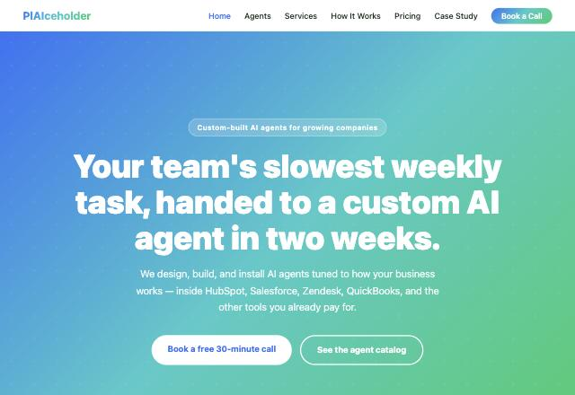
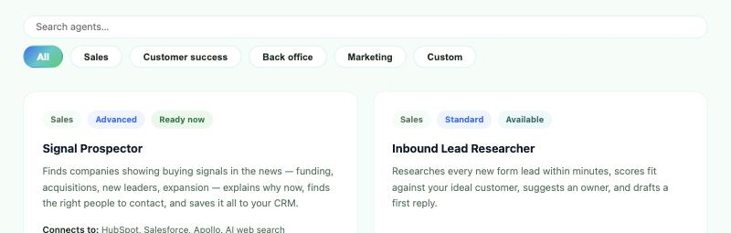
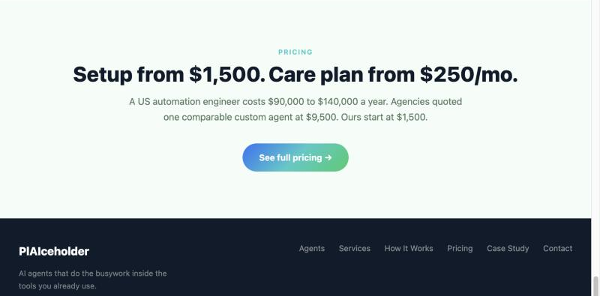
How it looks on plaiceholder.io
Hero: gradient with dot pattern · Catalog: pills and cards · Pricing band and navy footer

Slide 11
Three taglines, one promise
PRIMARY
AI agents that do the busywork inside the tools you already use.
HERO
Your team's slowest weekly task, handed to a custom AI agent in two weeks.
SHORT
Installed. Tuned. Proven.
Hero badge: “Custom-built AI agents for growing companies”

Slide 12
Five proof points, always in this order
1
2
3
4
5
Your tools
Your AI
Proven first
A yes first
You own it
HubSpot, Salesforce, Apollo, Zendesk, Slack, QuickBooks, spreadsheets
Claude, ChatGPT, Perplexity, Grok, Gemini or Copilot
A 20-record pilot with a measured result
Nothing is written or spent without approval
It runs in your accounts with your keys

Slide 13
Plain, calm, specific
We say
We never say
✓ “Built, tested, and running on sample data today.”
✕ “Revolutionary AI-powered solutions”
✓ “Nothing is written or spent without a yes.”
✕ “Fully autonomous, set it and forget it”
✓ “Your team sends emails and pays invoices.”
✕ “Replace your team with AI”
✓ “Usually a few cents per record.”
✕ “Unlimited AI for one low price!”

Slide 14
Four writing rules
< 25
#
words per sentence
numbers, names, dates
Lead with the task and the outcome, then the technology.
Specifics instead of adjectives like seamless or cutting-edge.
0
you
unmeasured claims
second person, active
Real numbers and quotes only, with the client's permission.
“Your team”, active voice, US English.

Slide 15
Show the work: the five-step diagram
🔌
🧠
✅
📝
👀
Pull
Think
Check
Write back
Show and ask
data from tools you pay for
AI does the judgment work
rules catch AI mistakes
results where you work
a dashboard and a yes
✓ Dashboards, before-and-after tables, this diagram
✓ Gradient banners with the dot pattern
✓ Label samples: “Sample data. Companies shown are fictional.”
✕ Stock robots, glowing brains, circuit boards, people pointing at screens

Slide 16
Name agents by the job they do
Deliverables
Function + noun
Title pages: white wordmark on the gradient
Tables: navy header, mint rows
Files: client-agent-vN.zip
Signal Prospector
Renewal Risk Radar
Invoice Checker
[Founder Name]
Founder, PlAIceholder
AI agents that do the busywork inside the tools you already use.
plaiceholder.io · [Booking Link]
No made-up words, no “-ify”, no “GPT” in names. Start copy with the job: “Signal Prospector finds…”

Slide 17
Installed. Tuned. Proven.
plaiceholder.io

